Slide 1




NEXT GEN EMPLOYABILITY PROGRAM
Creating a future-ready workforce
Team Members
College Name
Student Name :Tamilselvan.T
Student ID :au951221104054
JP College Of Engineering

Slide 2

CAPSTONE PROJECT SHOWCASE
Project Title
Voting Web Application using Django Framework
Abstract | Problem Statement | Project Overview | Proposed Solution | Technology Used | Modelling & Results | Conclusion

Slide 3
Abstract
In the realm of web development, the Django framework stands as a formidable tool for crafting dynamic and feature-rich applications. Django's robust ecosystem accelerates development through its "batteries included" approach, providing built-in solutions for common tasks like authentication and database management. The framework's Object-Relational Mapping (ORM) simplifies database interactions, enhancing productivity while ensuring security through its in-built protection mechanisms. However, Django's opinionated structure may present a learning curve for newcomers, and its monolithic nature could introduce performance overhead in certain scenarios.
Source :

Slide 4
Problem Statement
The problem at hand is to design and develop a robust web-based voting application using the Django framework.
The objective is to create a platform where users can participate in polls or surveys by casting their votes on various questions or topics.
The application should allow users to view a list of available questions, select a question of interest, and submit their votes for one or more choices provided for that question.
The goal is to deliver a voting application that is intuitive, secure, and scalable, providing an engaging user experience while enabling administrators to effectively manage the voting process.
Source :

Slide 5
Project Overview
The project aims to develop a sophisticated web-based voting application leveraging the Django framework, designed to facilitate digital polls, surveys, or elections for organizations, institutions, or communities.
With a focus on user engagement and transparency, the application's key features include robust user authentication and registration functionalities, ensuring secure access to the voting platform.
Administrators will have comprehensive control over the poll creation and management process, enabling customization of poll parameters such as titles, descriptions, and question types.
Participants will interact with an intuitive voting interface, equipped to handle various question formats and provide real-time feedback on active polls.
Source :

Slide 6
Proposed Solution
.
The proposed solution involves the development of a comprehensive web-based voting application using Django, tailored to meet the diverse needs of organizations, institutions, or communities seeking efficient and transparent voting processes. The solution will comprise the following components and functionalities:
1.User Authentication and Registration.
2.Poll Creation and Management.
3.Voting Interface.
4.Real-time Updates and Notifications.
5.Transparent and Auditable Process.
6.Scalability and Performance Optimization.
7.Reporting and Analytics.
8.Compliance and Security.
Source :

Slide 7
Advantages:
Efficiency: Utilizing the Django framework allows for rapid development of the voting application, thanks to its built-in features and conventions. This accelerates the development process and reduces time-to-market.
Security: Django incorporates security features by default, such as protection against common web vulnerabilities like SQL injection and cross-site scripting (XSS). Additionally, Django's authentication system helps in securely managing user accounts and permissions.
Community Support: Django has a large and active community of developers who contribute to its ecosystem. This ensures the availability of extensive documentation, third-party packages, and community support, making it easier to troubleshoot issues and implement new features.
Source :

Slide 8
Disadvantages:
Learning Curve: Django has a steep learning curve, especially for beginners with limited experience in web development or Python programming. Developers may require time to grasp the framework's concepts and conventions.
Opinionated Framework: Django follows the "Django way" of doing things, which can be restrictive for developers who prefer more flexibility and freedom in their frameworks. This could lead to challenges when implementing custom or unconventional features.
Customization Limitations: While Django provides many built-in features, customization beyond its defaults can be challenging and may require diving into the framework's internals. This could pose difficulties when implementing highly specialized or unique requirements.
Source :

Slide 9




Technology Used
Front-end
Back-end
Source :

Slide 10
Modelling & Results
In developing a voting application using Django, meticulous attention is directed towards both modeling the underlying data structure and effectively presenting the voting results to users.
Through Django's model system, the application's data architecture is meticulously crafted, typically featuring models like Question and Choice to represent the polls and available choices.
Once users have participated in the voting process, conveying the results to them becomes paramount.
Leveraging Django's templating system, the application dynamically generates HTML templates that vividly present the voting outcomes in an intuitive and visually engaging manner.
Furthermore, the application may utilize charting libraries or custom visualization techniques to elucidate the distribution of votes across different options, offering users valuable insights into the voting process's outcome.
Source :

Slide 11
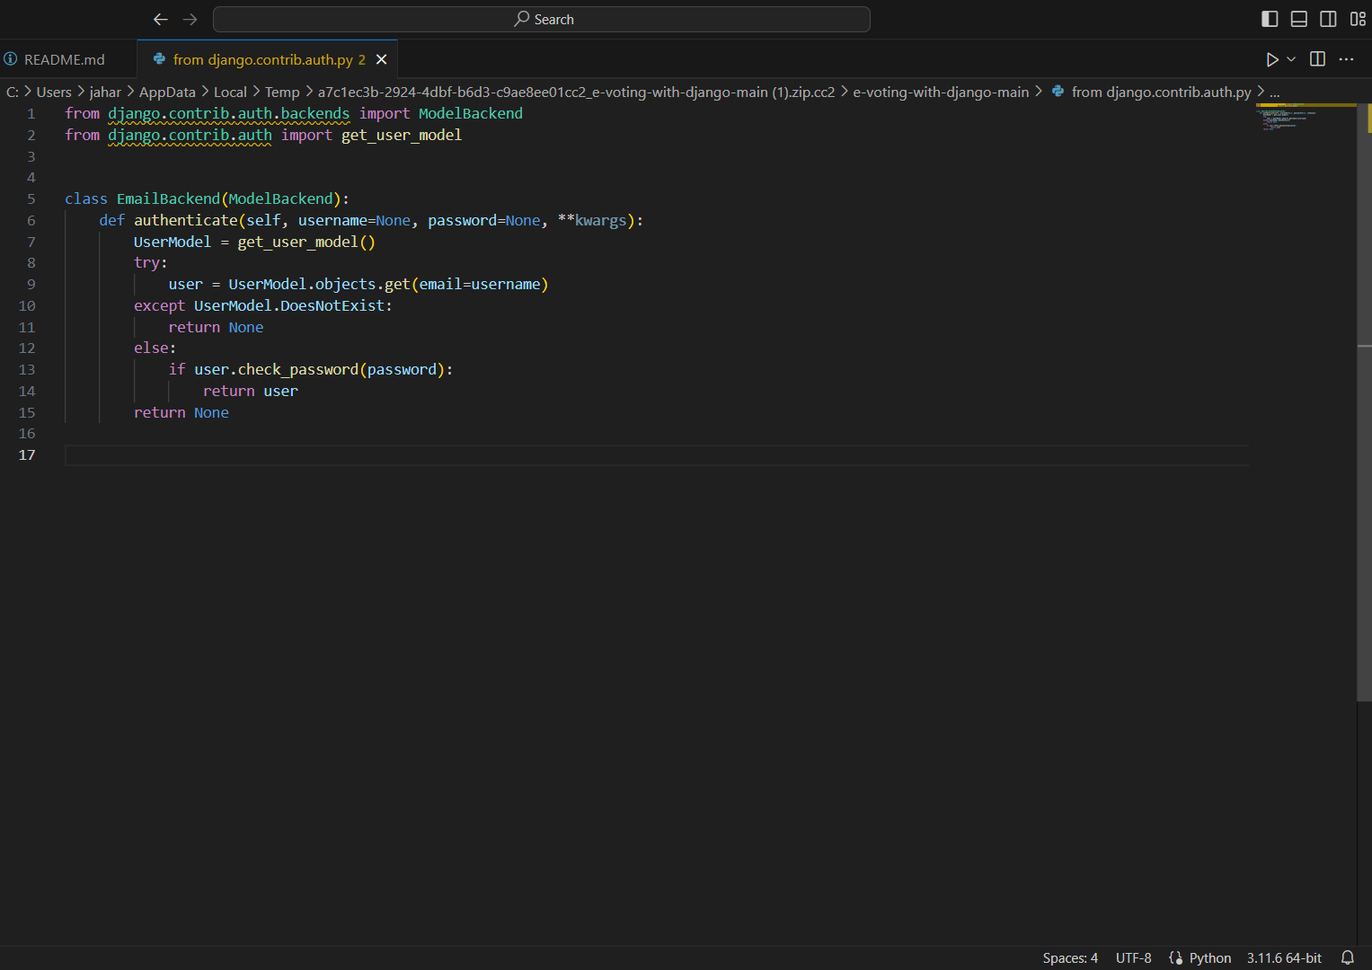
Homepage

Slide 12
About-Us-Page
1.Credibility:
The "About Us" page establishes credibility by providing information about the organization's history, mission, and team members
2.Mission and Values:
It communicates the organization's mission, values, and objectives in promoting democratic participation and decision-making.
3. Community Engagement:
The page showcases the organization's commitment to community engagement and empowerment through the voting process, inspiring active participation.
4. Contact Information:
Users can easily reach out with questions, feedback, or inquiries about the voting application through the contact information provided on the page.

Slide 13
Service-Page
1.Header Section
2.Introduction section
3.User Services
4.Administrator Services
5.Organizational Services
6.Technical Services
7.Consulting Services
8.Call to Action Services

Slide 14
Departments-Page
Header Section
Introduction Section
Department Listings
Department Details
Key Personnel
Collaboration Opportunities
Footer Section

Slide 15
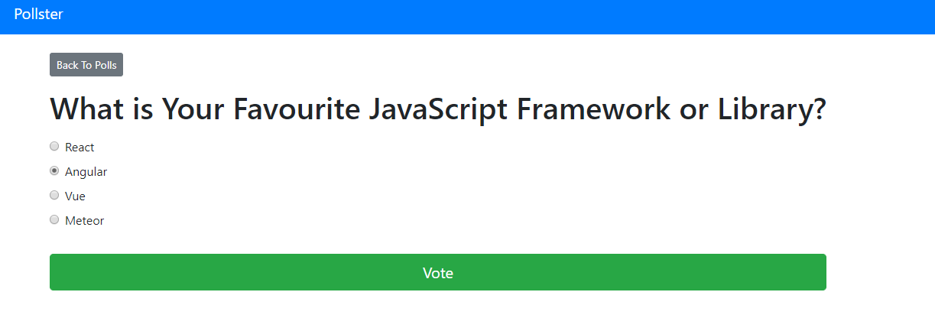
Blog-Page

Slide 16
Future Enhancements:
In the pursuit of advancing the voting application, several avenues for enhancement present themselves to enrich its functionality and user engagement.
One promising direction is the integration of advanced analytics tools, enabling administrators to glean deeper insights into voting behaviors, demographic trends, and predictive modeling for future electoral outcomes.
Furthermore, the incorporation of social media integration could amplify user engagement by allowing participants to share their voting activities and poll results seamlessly across popular platforms, fostering a wider reach and encouraging community involvement.
Real-time collaboration features offer another avenue for enhancement, empowering teams or committees to collaboratively create and refine polls, enhancing decision-making processes.

Slide 17
Conclusion
In conclusion, the development of the voting application using the Django framework has provided a solid foundation for facilitating democratic participation and decision-making processes. Through meticulous modeling of the data structure and thoughtful presentation of voting results, the application delivers a seamless and transparent user experience. However, the journey does not end here. By embracing future enhancements such as advanced analytics, social media integration, real-time collaboration, and mobile accessibility, the application can evolve to meet the evolving needs of its users and administrators. Ultimately, the voting application stands as a testament to the power of technology in fostering civic engagement, empowering individuals, and upholding the principles of democracy.
Source :

Slide 18
Thank You!
Notes:
Thank You !!

